Slide 1
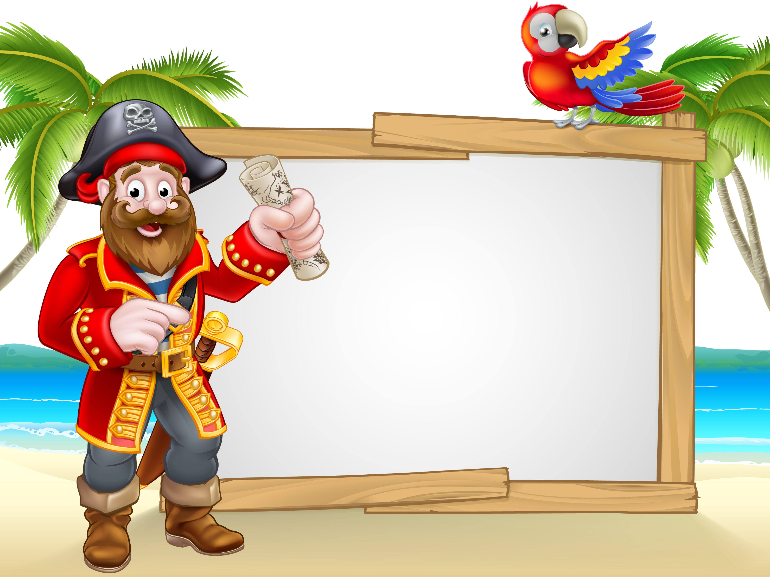
Welcome
to the
Treasure Hunt
Notes:
#FFFBD5 for background color! #966b3b brown ; sand dark: #e4cd95

Slide 2

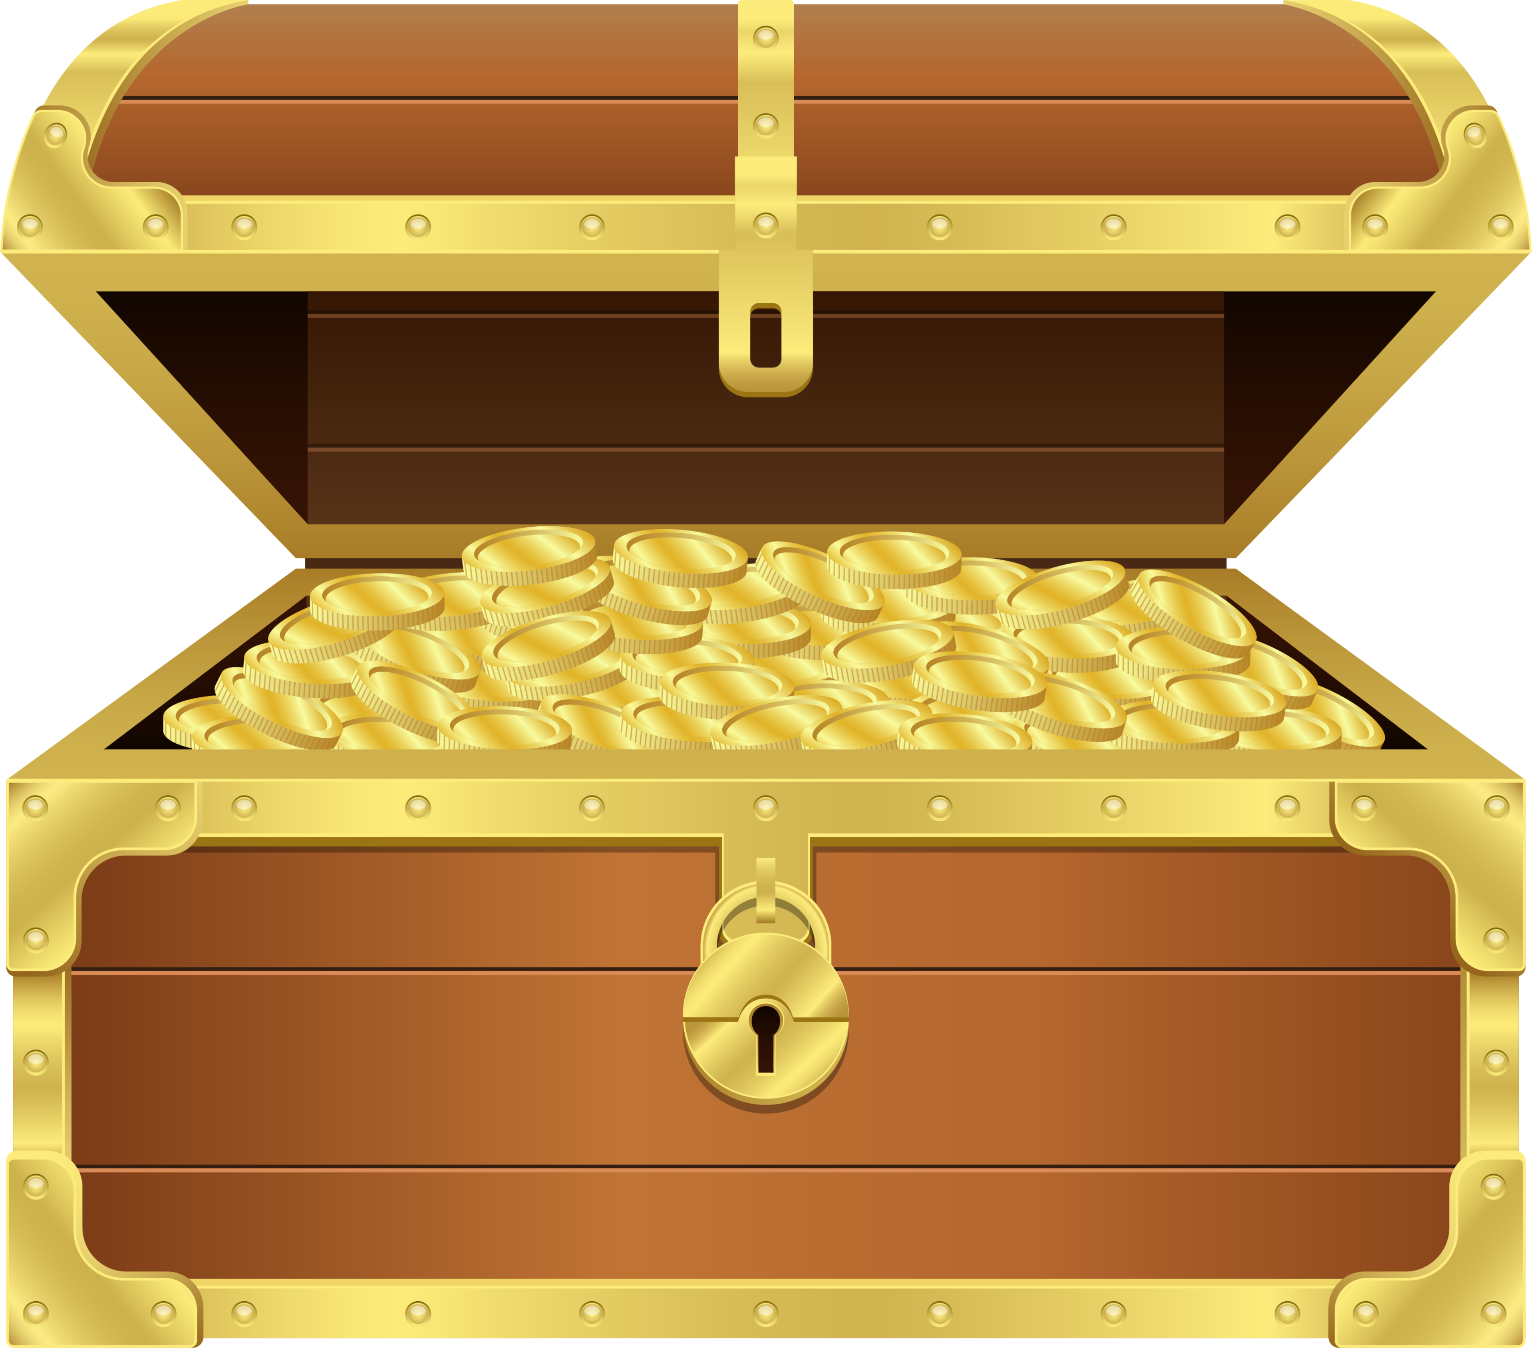

Today, you can win a treasure by investing coins.
You will be paid a bonus based on the number of coins you keep and whether you win the treasure.

Slide 3
In each round of the game, you start with 4 coins. You can choose to either keep them or invest them.
You

Slide 4
In each round of the game, your opponent starts with 5 coins. They can choose to either keep them or invest them.
Opponent

Slide 5
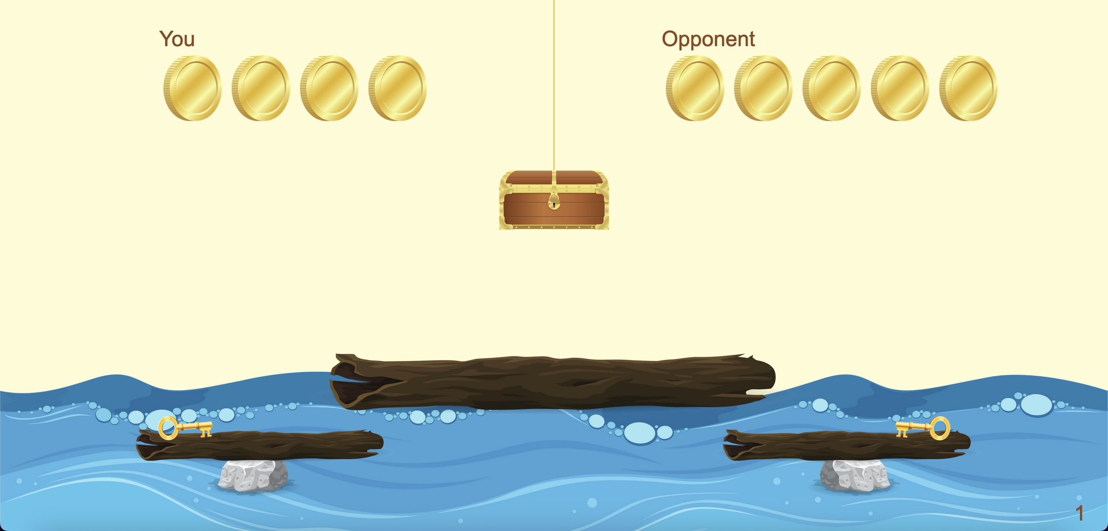
This is how the task screen looks:
Your goal is to open and win the treasure in the middle by investing more coins than the opponent.

Slide 6

If you invest more coins than your opponent, you receive a key to the treasure chest and win 10 coins.

Slide 7
At the start of each round, this is what the game screen looks like.

Slide 8
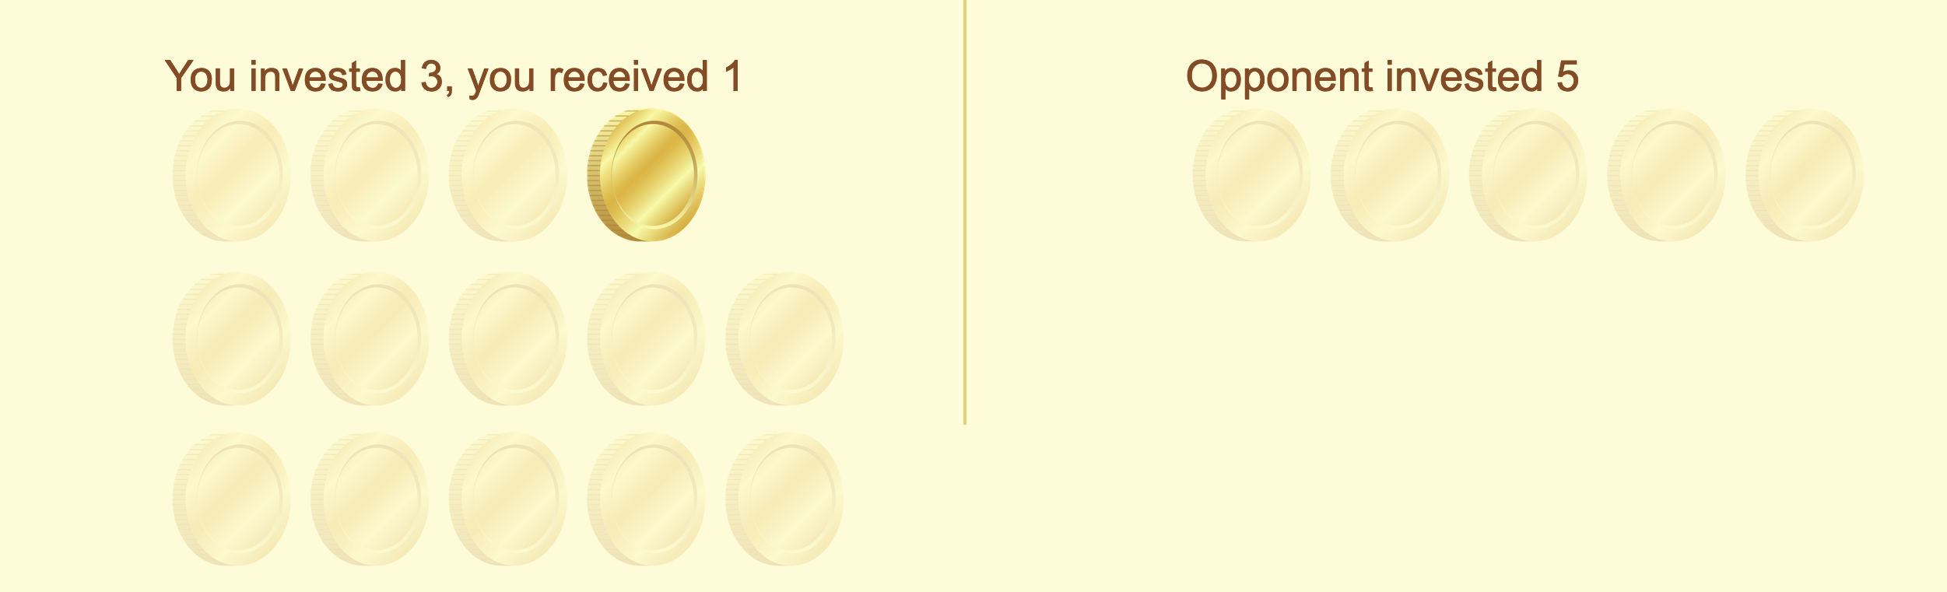
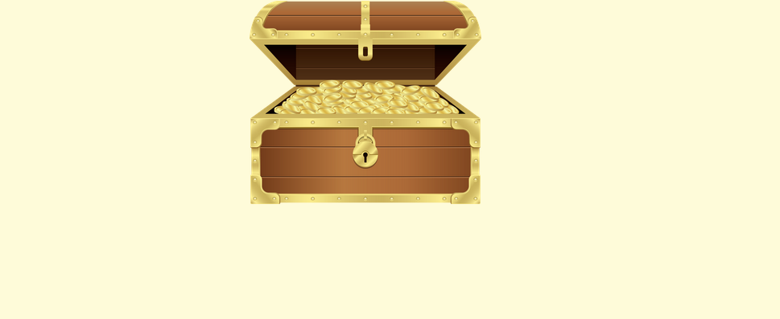
At the end of each round, this is what the game screen looks like.
Coins invested
Coins kept
Coins from the treasure (not won in this case)

Slide 9
Here, you invested 3 coins and your opponent 1. Because you invested more, you win 11 coins (1 kept, 10 from treasure). Please play the video.
Notes:
PLACE VIDEO HERE IN SCRIPT

Slide 10
Here, you invested 2 coins and your opponent 5. They win the key to the treasure, because you invested less. You keep 2 coins. Please play the video.
Notes:
PLACE VIDEO HERE IN SCRIPT

Slide 11
Here, you and your opponent invested 3 coins each. No one wins the key; the chest stays locked. You keep 1 coin.
Please play the video.
Notes:
PLACE VIDEO HERE IN SCRIPT

Slide 12
In each round, besides winning (or not winning) the treasure,
you’ll also get to keep any coins that you didn’t invest and
are still on your side of the screen.

Slide 13

For example, you invested 2 coins and kept 2 coins. And you won.
Your final prize will be the 2 coins kept plus the treasure chest.
+

Slide 14
You will play several rounds of the game.
The opponent that you play with will be another person on each round.
Your opponent's choice is picked from one of 14 players who have played the game before.

Slide 15


To play the game,
use the left and right arrow keys on your keyboard to decide how many coins (0-4) you want to invest.
⬅️ ➡️
Press the right arrow to invest 1 more coin.
Press the left arrow to invest 1 less coin.

Slide 16
Thus, if you press the right arrow key twice, you will invest 2 coins.
➡️
➡️
If you, then, press the left arrow key once, you will only invest 1 coin.
⬅️

Slide 17
This is how it will look in the game, if you first press the right arrow twice and then the left arrow once.
Please play the video.
Notes:
PLACE VIDEO HERE IN SCRIPT

Slide 18

When you've decided how many coins you want to invest, press the space bar.
After that, you’ll see what your opponent picked!
Finally, you’ll find out who wins the key to the treasure!

Slide 19
After one of you wins the treasure,
you will automatically move on to the next round of the game!
Let's try it out for real! Press 'next' to give it a go!

Slide 20
Notes:
Let them play two rounds of the game.

Slide 21
After finishing the game, we'll randomly select one round to see how much you won in that round ($0 to $14).
And guess what?
You get to take this money home with you!

Slide 22
Remember: the bonus will depend on how well you did in one round chosen randomly. Since any round can be chosen, try your best in every round!
Don’t worry if you don’t win the treasure – you may still get a bonus from your coins kept!
Please answer the following questions to show you understand how the game works.

Slide 23
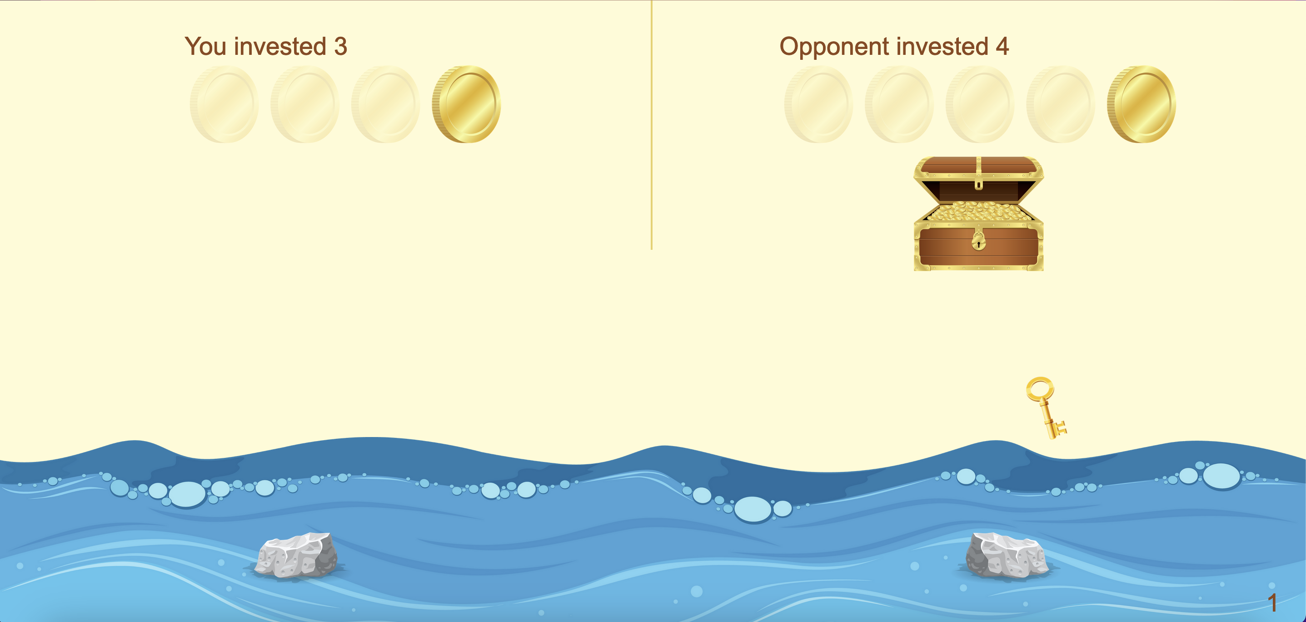
True or False?
In this round, you win 1 coin, and your opponent wins 11 coins.
Notes:
That is correct!
Your opponent comes from one of 14 people who have played this game before. You will be randomized so that you will not know which of the 14 you are playing against in any given round.
However, recall that you go through the game in the same order as the opponent. If you are playing the fifth round, your opponent is also playing in their fifth round.
That is incorrect.
Your opponent comes from one of 14 people who have played this game before. You will be randomized so that you will not know which of the 14 you are playing against in any given round.
However, recall that you go through the game in the same order as the opponent. If you are playing the fifth round, your opponent is also playing in their fifth round.

Slide 24
That is correct!
👍🏽
Once the treasure chest unlocks, you get to keep everything on your side of the screen, and your opponent gets to keep everything on their side of the screen!
Notes:
That is correct!
After you have confirmed your investment amount by pressing the space bar you are unable to change your investment.
That is incorrect.
After you have confirmed your investment amount by pressing the space bar you are unable to change your investment.

Slide 25
That is incorrect.
👎🏽
Once the treasure chest unlocks, you get to keep everything on your side of the screen, and your opponent gets to keep everything on their side of the screen!
Notes:
That is correct!
After you have confirmed your investment amount by pressing the space bar you are unable to change your investment.
That is incorrect.
After you have confirmed your investment amount by pressing the space bar you are unable to change your investment.

Slide 26
True or False?
Your opponent will be the same in each round.
Notes:
That is correct!
Your opponent comes from one of 14 people who have played this game before. You will be randomized so that you will not know which of the 14 you are playing against in any given round.
However, recall that you go through the game in the same order as the opponent. If you are playing the fifth round, your opponent is also playing in their fifth round.
That is incorrect.
Your opponent comes from one of 14 people who have played this game before. You will be randomized so that you will not know which of the 14 you are playing against in any given round.
However, recall that you go through the game in the same order as the opponent. If you are playing the fifth round, your opponent is also playing in their fifth round.

Slide 27
That is correct!
👍🏽
Your opponent is one of several people who played this game before. You won’t know which one you’re playing against because it’s random each round.
Notes:
That is correct!
After you have confirmed your investment amount by pressing the space bar you are unable to change your investment.
That is incorrect.
After you have confirmed your investment amount by pressing the space bar you are unable to change your investment.

Slide 28
That is incorrect.
👎🏽
Your opponent is one of several people who have played this game before. You won’t know who they are because it's random each round.
Notes:
That is correct!
After you have confirmed your investment amount by pressing the space bar you are unable to change your investment.
That is incorrect.
After you have confirmed your investment amount by pressing the space bar you are unable to change your investment.

Slide 29
True or False?
You will know how many coins your opponent starts with.
Notes:
That is correct!
You will know the opponent's starting amount, just as they will know yours as indicated by the grey filled boxes at the start of each round.
That is incorrect.
You will know the opponent's starting amount, just as they will know yours as indicated by the grey filled boxes at the start of each round.

Slide 30
That is correct!
👍🏽
You’ll know how many coins your opponent starts with, and they’ll know how many you have. The coins will be shown at the start of each round.
Notes:
That is correct!
You will know the opponent's starting amount, just as they will know yours as indicated by the grey filled boxes at the start of each round.
That is incorrect.
You will know the opponent's starting amount, just as they will know yours as indicated by the grey filled boxes at the start of each round.

Slide 31
That is incorrect.
👎🏽
You will know how many coins your opponent starts with, and they will know yours too. The coins will be shown at the start of each round.
Notes:
That is correct!
You will know the opponent's starting amount, just as they will know yours as indicated by the grey filled boxes at the start of each round.
That is incorrect.
You will know the opponent's starting amount, just as they will know yours as indicated by the grey filled boxes at the start of each round.

Slide 32
True or False?
You picked 4 coins to invest and pressed space, but then you changed your mind. You can choose a new amount to invest.
Notes:
That is correct!
After you have confirmed your investment amount by pressing the space bar you are unable to change your investment.
That is incorrect.
After you have confirmed your investment amount by pressing the space bar you are unable to change your investment.

Slide 33
That is correct!
👍🏽
Once you press the space bar to confirm your investment, you can’t change it.
Notes:
That is correct!
After you have confirmed your investment amount by pressing the space bar you are unable to change your investment.
That is incorrect.
After you have confirmed your investment amount by pressing the space bar you are unable to change your investment.

Slide 34
That is incorrect.
👎🏽
Once you press the space bar to confirm your investment, you can’t change it.
Notes:
That is correct!
After you have confirmed your investment amount by pressing the space bar you are unable to change your investment.
That is incorrect.
After you have confirmed your investment amount by pressing the space bar you are unable to change your investment.

Slide 35
True or False?
Use the right and left arrow keys to pick how many coins (0-4) you want.
Press the space bar to make your choice.
After the treasure is shown, you will automatically move to the next round.
Notes:
That is correct!
That is incorrect.

Slide 36
That is correct! 👍🏽
Use the arrow keys to choose your coins.
Press the space bar to confirm.
After you see the treasure, you will automatically go to the next round.

Slide 37
That is incorrect! 👎🏽
Use the arrow keys to choose your coins.
Press the space bar to confirm.
After you see the treasure, you will automatically go to the next round.

Slide 38
The game has 80 rounds and lasts about 15 minutes.
Now the game begins.
🤩
Happy treasure hunting!

