Slide 1




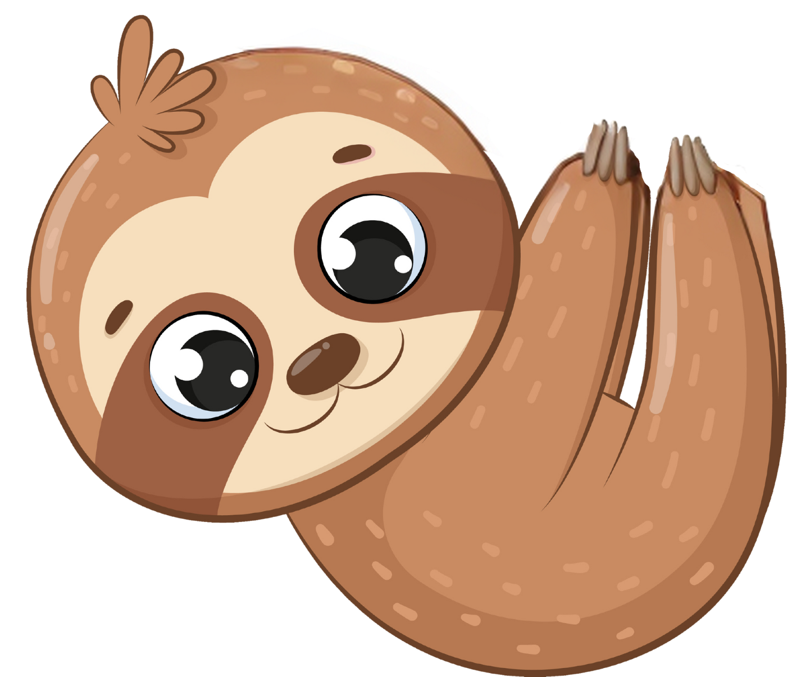
Bananas from trees that you did NOT choose are no longer displayed.

